Slide 1
JavaScript Essentials
Loops

Slide 2
Table of Contents
Overview
Famous for loop
Break the loops
Skip iterations with continue
while and do…while
Which loop should i use?
Q&A

Slide 3

Lesson Objectives
Understand the importance of loops in Programming
Able to use loops in JavaScript to complete repetitive tasks
Understand the difference of for, while and do…while loop
Know when to use for loop and when to use while and do…while loop

Slide 4
Overview
Section 1

Slide 5
Overview
Programming languages are very useful for rapidly completing repetitive tasks, for example: compute sum, product of an array
Programming loops are all to do with doing the same thing over and over again — which is termed iteration in programming speak.

Slide 6
Overview
Let's consider the case of a farmer that is making sure he has enough food to feed his family for the week. He might use the following loop to achieve this:

Slide 7
Overview
A loop usually has one or more of the following features:
A counter
An exit condition
An iterator
Notes:
A counter, which is initialized with a certain value — this is the starting point of the loop ("Start: I have no food", above).
An exit condition, which is the criteria under which the loop stops — usually the counter reaching a certain value. This is illustrated by "Have I got enough food?", above. Let's say he needs 10 portions of food to feed his family.
An iterator, which generally increments the counter by a small amount on each successive loop, until it reaches the exit condition. We haven't explicitly illustrated this above, but we could think about the farmer being able to collect say 2 portions of food per hour. After each hour, the amount of food he has collected is incremented by two, and he checks whether he has enough food. If he has reached 10 portions (the exit condition), he can stop collecting and go home.

Slide 8
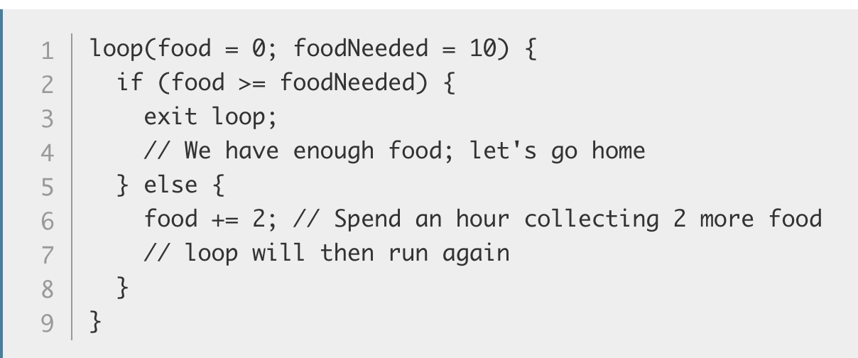
Overview
In pseudocode, this would look something like the following:
Notes:
So the amount of food needed is set at 10, and the amount the farmer currently has is set at 0. In each iteration of the loop, we check whether the amount of food the farmer has is larger or equal to the amount he needs. If so, we can exit the loop. If not, the farmer spends an hour collecting two portions of food, and the loop runs again.

Slide 9
Overview – Why loop?
loops are all to do with doing the same thing over and over again, which is great for rapidly completing repetitive tasks.
Loops are what make you into a Programmer
Remember what Bill Gates said?
Notes:
At this point, you probably understand the high-level concepts behind loops, but you are probably thinking "OK, great, but how does this help me write better JavaScript code?" As we said earlier, loops are all to do with doing the same thing over and over again, which is great for rapidly completing repetitive tasks.
Often, the code will be slightly different on each successive iteration of the loop, which means that you can complete a whole load of tasks that are similar but slightly different — if you've got a lot of different calculations to do, you want to do each different one, not the same one over and over again!

Slide 10
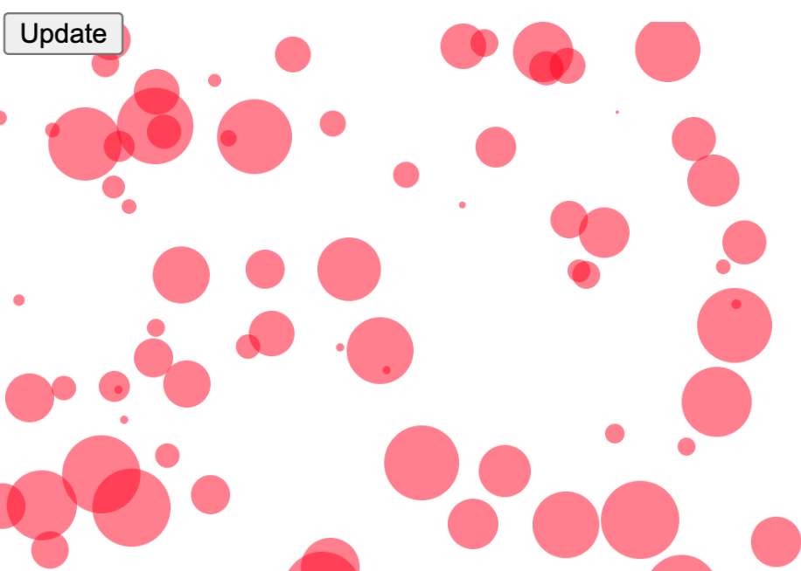
Overview – Why loop?
Demo 1: Let's say we wanted to draw 100 random circles on a <canvas> element (press the Update button to run the example again and again to see different random sets)
Notes:
Check Unit 08 – Demo 1

Slide 11
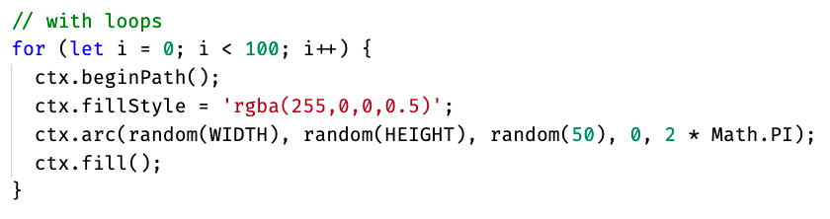
Overview – Why loop?

Slide 12
Overview – Why loop?
Notes:
You should get the basic idea — we are using a loop to run 100 iterations of this code, each one of which draws a circle in a random position on the page. The amount of code needed would be the same whether we were drawing 100 circles, 1000, or 10,000. Only one number has to change.
If we weren't using a loop here, we'd have to repeat the following code for every circle we wanted to draw:
This would get very boring and difficult to maintain very quickly. Loops really are the best.

Slide 13
Overview – Summary
Loops are all to do with doing the same thing over and over again (which is termed iteration in programming speak)
Loops are essentials for rapidly completing repetitive tasks
Every time you do a same tasks over and over think about loops
Remember the mind of Programmer: Don’t repeat – be lazy

Slide 14
Famous for loop
Section 2

Slide 15
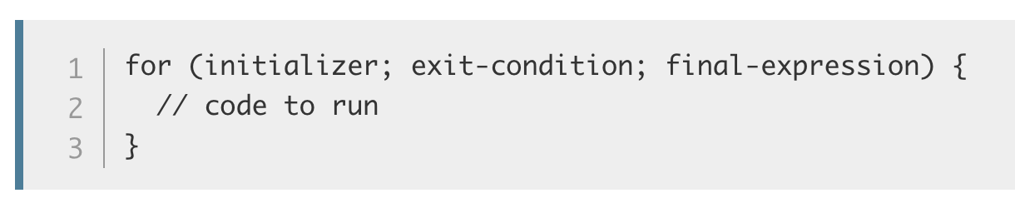
Famous for loop
Let's start exploring some specific loop constructs. The first, which you'll use most of the time, is the for loop — this has the following syntax:
Notes:
Here we have:
The keyword for, followed by some parentheses.
Inside the parentheses we have three items, separated by semi-colons:
An initializer — this is usually a variable set to a number, which is incremented to count the number of times the loop has run. It is also sometimes referred to as a counter variable.
An exit-condition — as mentioned before, this defines when the loop should stop looping. This is generally an expression featuring a comparison operator, a test to see if the exit condition has been met.
A final-expression — this is always evaluated (or run) each time the loop has gone through a full iteration. It usually serves to increment (or in some cases decrement) the counter variable, to bring it closer to the exit condition value.
Some curly braces that contain a block of code — this code will be run each time the loop iterates.

Slide 16
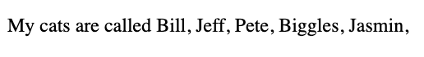
Famous for loop
Demo 2: print out cat names using for loop
Notes:
Check Unit 8 – Demo 2:
This shows a loop is used to iterate over the items in an array and do something with each of them — a very common pattern in JavaScript. Here:
The counter variable (sometimes known as an initializer or an iteration variable), i, starts at 0 (let i = 0).
The loop has been told to run until i is no longer smaller than the length of the cats array. This is important — the exit condition shows the condition under which the loop will still run. So in this case, while i < cats.length is still true, the loop will still run.
Inside the loop, we concatenate the current loop item (cats[i] , which is cats[whatever i is at the time]) along with a comma and space, onto the end of the info variable. So:
During the first run, i = 0, therefore cats[0] + ', ' (which is equal to Bill, ) will be concatenated onto info.
During the second run, i = 1, so cats[1] + ', ' (which is equal to Jeff, ) will be concatenated onto info.
And so on. After each time the loop has run, 1 will be added to i (i++), then the process will start again.
When i becomes equal to cats.length (in this case, 5), the loop will stop, and the browser will move on to the next bit of code below the loop.
Note: We have made the exit condition i < cats.length, not i <= cats.length, because computers count from 0, not 1 — we are starting i at 0, and going up to i = 4 (the index of the last array item). cats.length returns 5, as there are 5 items in the array, but we don't want to get up to i = 5, as that would return undefined for the last item (there is no array item with an index of 5). So, therefore, we want to go up to 1 less than cats.length (i <), not the same as cats.length (i <=).
Note: A common mistake with exit conditions is making them use "equal to" (===) rather than say "less than or equal to" (<=). If we wanted to run our loop up to i = 5, the exit condition would need to be i <= cats.length. If we set it to i === cats.length, the loop would not run at all because i is not equal to 5 on the first loop iteration, so it would stop immediately.

Slide 17
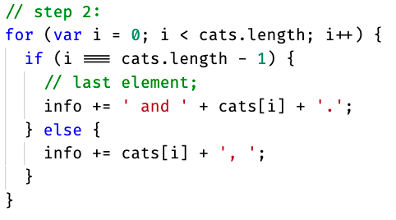
Famous for loop
One small problem we are left with is that the final output sentence isn't very well-formed
Ideally, we want to change the concatenation on the final loop iteration so that we haven't got a comma on the end of the sentence

Slide 18
Famous for loop - Important
Attention: make sure that the initializer is incremented or, depending on the case, decremented, so that it eventually reaches the exit condition.
If not, the loop will go on forever, and either the browser will force it to stop, or it will crash. This is called an infinite loop

Slide 19
Famous for loop - Overview
Syntax for for loop is: for (initializer; exit-condition; final-expression) { // code to run }
For loop is commonly used when you know exactly the number of iteration for example loop every item of an array (n iteration where n is the length of the array)
Remember Computer starts a 0 so last item when you loop an array is n – 1 (where n is the length of the array)
Take care of the loop condition or you will get an Infinite loops (which is very bad)

Slide 20
Break the loops
Section 3

Slide 21
Break the loops
If you want to exit a loop before all the iterations have been completed, you can use the break statement.
We already met this in the previous article when we looked at switch statements
It's the same with loops — a break statement will immediately exit the loop and make the browser move on to any code that follows it.
Notes:
— when a case is met in a switch statement that matches the input expression, the break statement immediately exits the switch statement and moves onto the code after it.

Slide 22
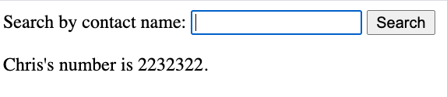
Break the loops - Example
Demo 3: Contact search

Slide 23
Break the loops – Practice 1
Practice 1: Use break to loop the 1st half of an array ?

Slide 24
Break the loops - Overview
A break statement will immediately exit the loop and make the browser move on to any code that follows it.
Use break when you want to loop a partition of the iterations for example: loop first half of an array
Use break outside of loops does not make sense

Slide 25
Skip iterations with continue
Section 4

Slide 26
Skip iterations with continue
The continue statement works in a similar manner to break, but instead of breaking out of the loop entirely, it skips current iteration and to the next iteration of the loop.
Notes:
Let's look at another example that takes a number as an input, and returns only the numbers that are squares of integers (whole numbers).

Slide 27
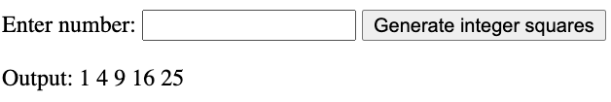
Skip iterations with continue
Demo 4: print all square root of a given number
Notes:
Enter 25 and press button

Slide 28
Skip iterations with continue - Summary
To skips to the next iteration of the loop use continue
continue is commonly used with conditionals statement such as if…else
Use continue outside of loop makes no sense

Slide 29
while and do…while
Section 5

Slide 30
while and do…while
for is not the only type of loop available in JavaScript.
There are actually many others and, while you don't need to understand all of these now, it is worth having a look at the structure of a couple of others so that you can recognize the same features at work in a slightly different way.

Slide 31
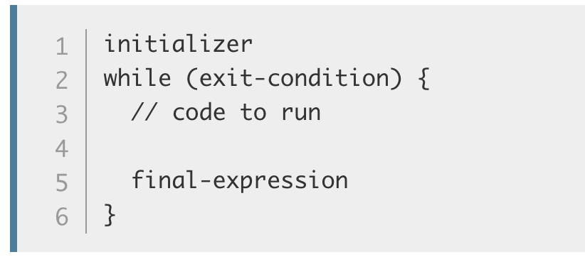
while and do…while
First, let's have a look at the while loop. This loop's syntax looks like so:

Slide 32
while and do…while
This works in a very similar way to the for loop
Except that:
the initializer variable is set before the loop, and the final-expression is included inside the loop after the code to run
The exit-condition is included inside the parentheses, which are preceded by the while keyword rather than for.

Slide 33
while and do…while
The same three items are still present, and they are still defined in the same order as they are in the for loop
You still have to have an initializer defined before you can check whether it has reached the exit-condition;
The final-condition is then run after the code inside the while loop.

Slide 34
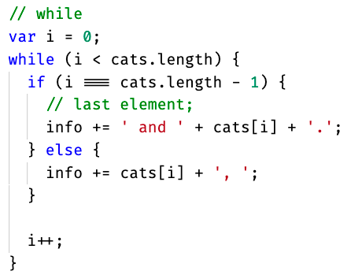
while and do…while
Demo 5: Let's have a look again at our cats list example, but rewritten to use a while loop:

Slide 35
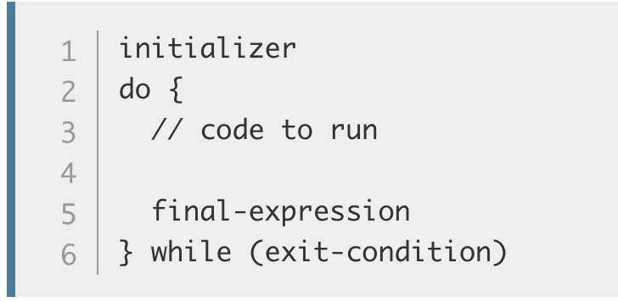
while and do…while
The do...while loop is very similar, but provides a variation on the while structure:

Slide 36
while and do…while
The initializer again comes first, before the loop starts.
The exit-condition comes after everything else, wrapped in parentheses and preceded by a while keyword.
In a do...while loop, the code inside the curly braces is always run once before the check (!!!)

Slide 37
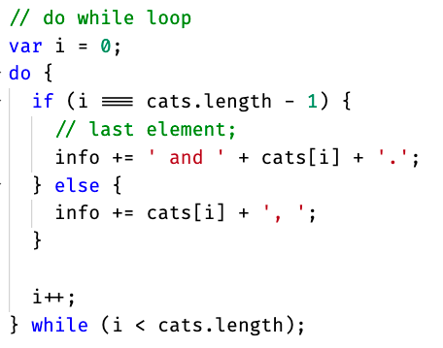
while and do…while
Demo 6: Let's rewrite our cat listing example again to use a do...while loop:
Notes:
Important: With while and do...while — as with all loops — you must make sure that the initializer is incremented or, depending on the case, decremented, so that it eventually reaches the exit condition. If not, the loop will go on forever, and either the browser will force it to stop, or it will crash. This is called an infinite loop.

Slide 38
while and do…while - Overview
while and do…while have very similar syntax
The difference: the exit-condition comes after everything else, wrapped in parentheses and preceded by a while keyword
With while and do...while — as with all loops — you must make sure that the initializer is incremented or, depending on the case, decremented, so that it eventually reaches the exit condition. If not, the loop will go on forever, and either the browser will force it to stop, or it will crash.
This is called an infinite loop
Notes:
Important: With while and do...while — as with all loops — you must make sure that the initializer is incremented or, depending on the case, decremented, so that it eventually reaches the exit condition. If not, the loop will go on forever, and either the browser will force it to stop, or it will crash. This is called an infinite loop.

Slide 39
Which loop should i use?
Section 6

Slide 40
Which loop should i use?
For basic uses, for, while, and do...while loops are largely interchangeable.
They can all be used to solve the same problems, and which one you use will largely depend on your personal preference — which one you find easiest to remember or most intuitive.

Slide 41
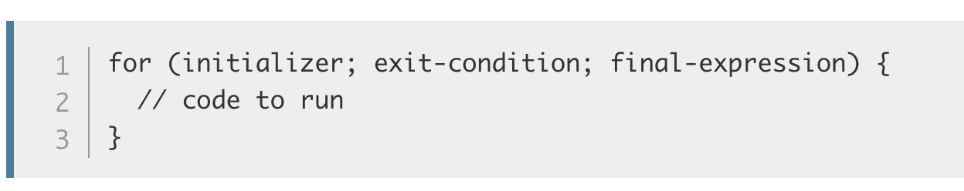
Which loop should i use?
First for loop:

Slide 42
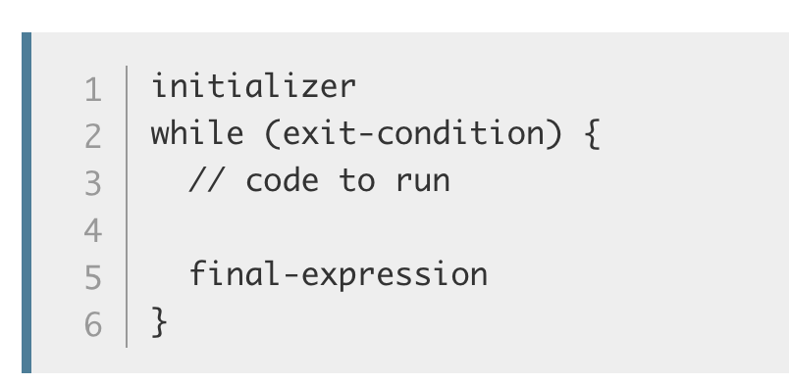
Which loop should i use?
while:

Slide 43
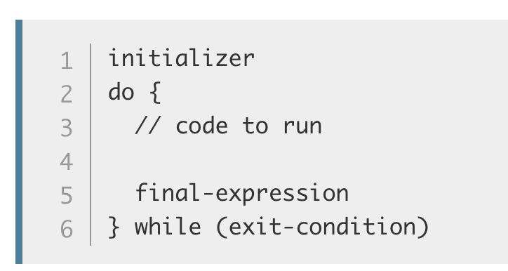
Which loop should i use?
do…while:

Slide 44
Which loop should i use?
We would recommend for, at least to begin with, as it is probably the easiest for remembering everything
The initializer, exit-condition, and final-expression all have to go neatly into the parentheses, so it is easy to see where they are and check that you aren't missing them.

Slide 45
Which loop should i use? - Overview
For basic uses, for, while, and do...while loops are largely interchangeable.
They can all be used to solve the same problems, and which one you use will largely depend on your personal preference — which one you find easiest to remember or most intuitive.
for is the recommended loop for beginner (and when looping arrays)

Slide 46

Thank you
Q&A

